Slide 1
AIR QUALITY INDEX CHECKER
App User Manual
By Navaneeth Ranjit

Slide 2

About Myself
At the age of 14, I'm Navaneeth Ranjit, and my journey in the coding world led me to the fascinating platform called Clevered. Through dedication and hard work, I've conquered nine levels on the platform, marking significant milestones in my coding proficiency. Recently, I successfully completed an internship, an enriching experience that wouldn't have been possible without the invaluable support and guidance from my mentor.

Slide 3
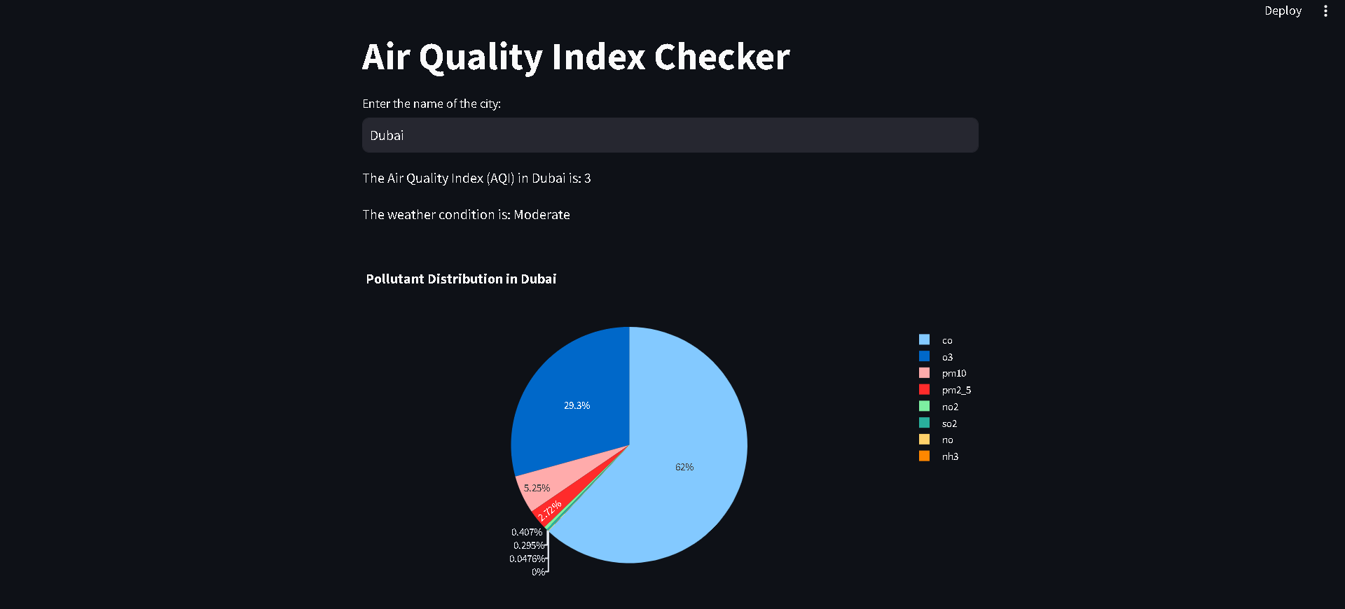
About The App
This app is an Air Quality Index Checker in which the user can select a specific city .The app tehn uses the selected city's name to obtain its geographical coordinates (latitude and longitude).AnOpenWeatherMap API key is used to fetch air quality information for the specified coordinates.

Slide 4
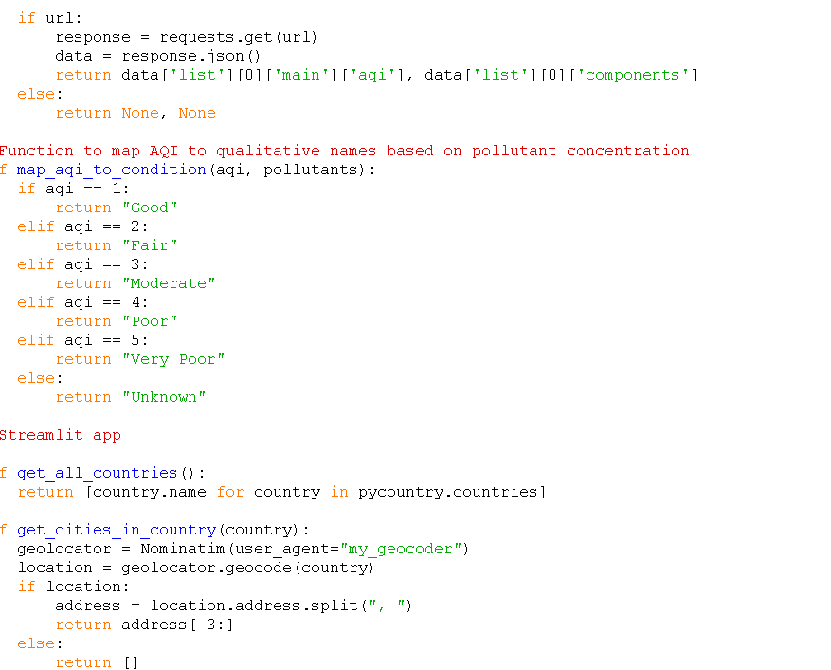
Air Quality Analysis:
The app analyzes the received air quality data, specifically the Air Quality Index (AQI) and pollutant components.

Slide 5
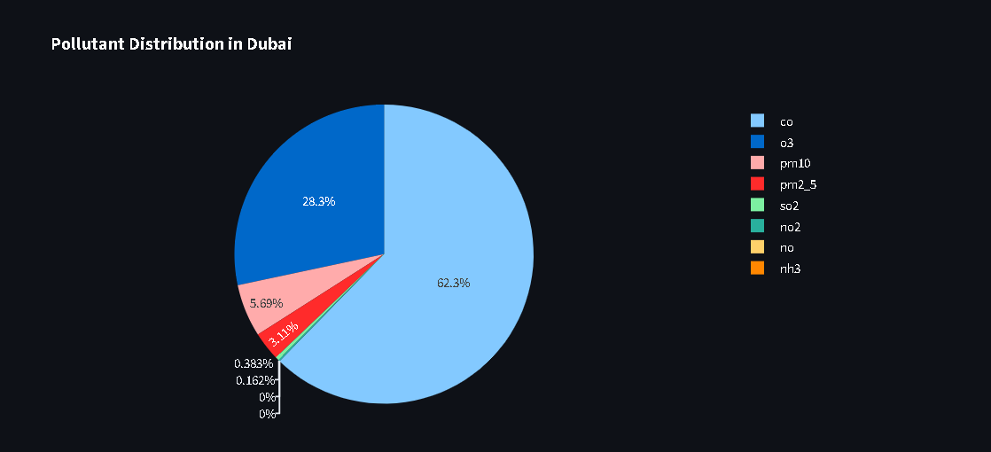
Result Display
The AQI and a qualitative weather condition based on pollutant concentration are displayed to the user.If successful, a pie chart is generated to visually represent the distribution of pollutant components in the selected city.

Slide 6
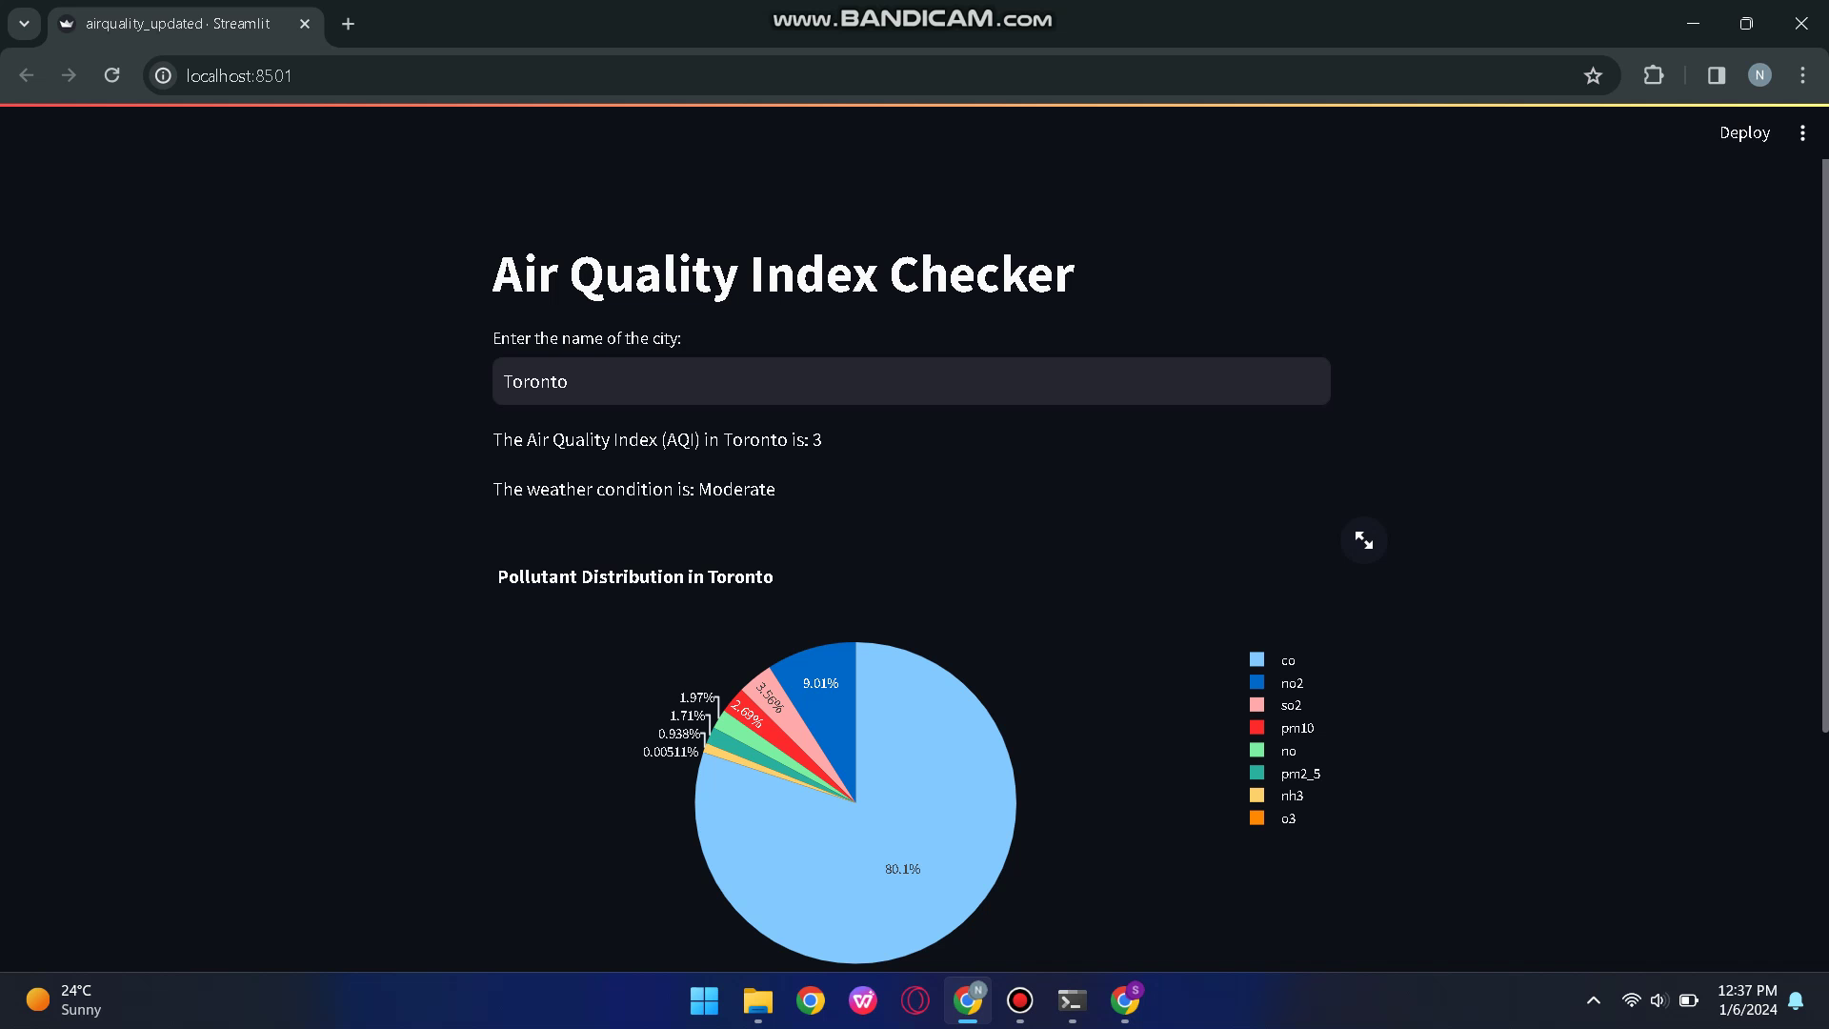

Slide 7
Contact Me On:
navirn2009@gmail.com

Slide 8
THANK YOU !

